Slide 1
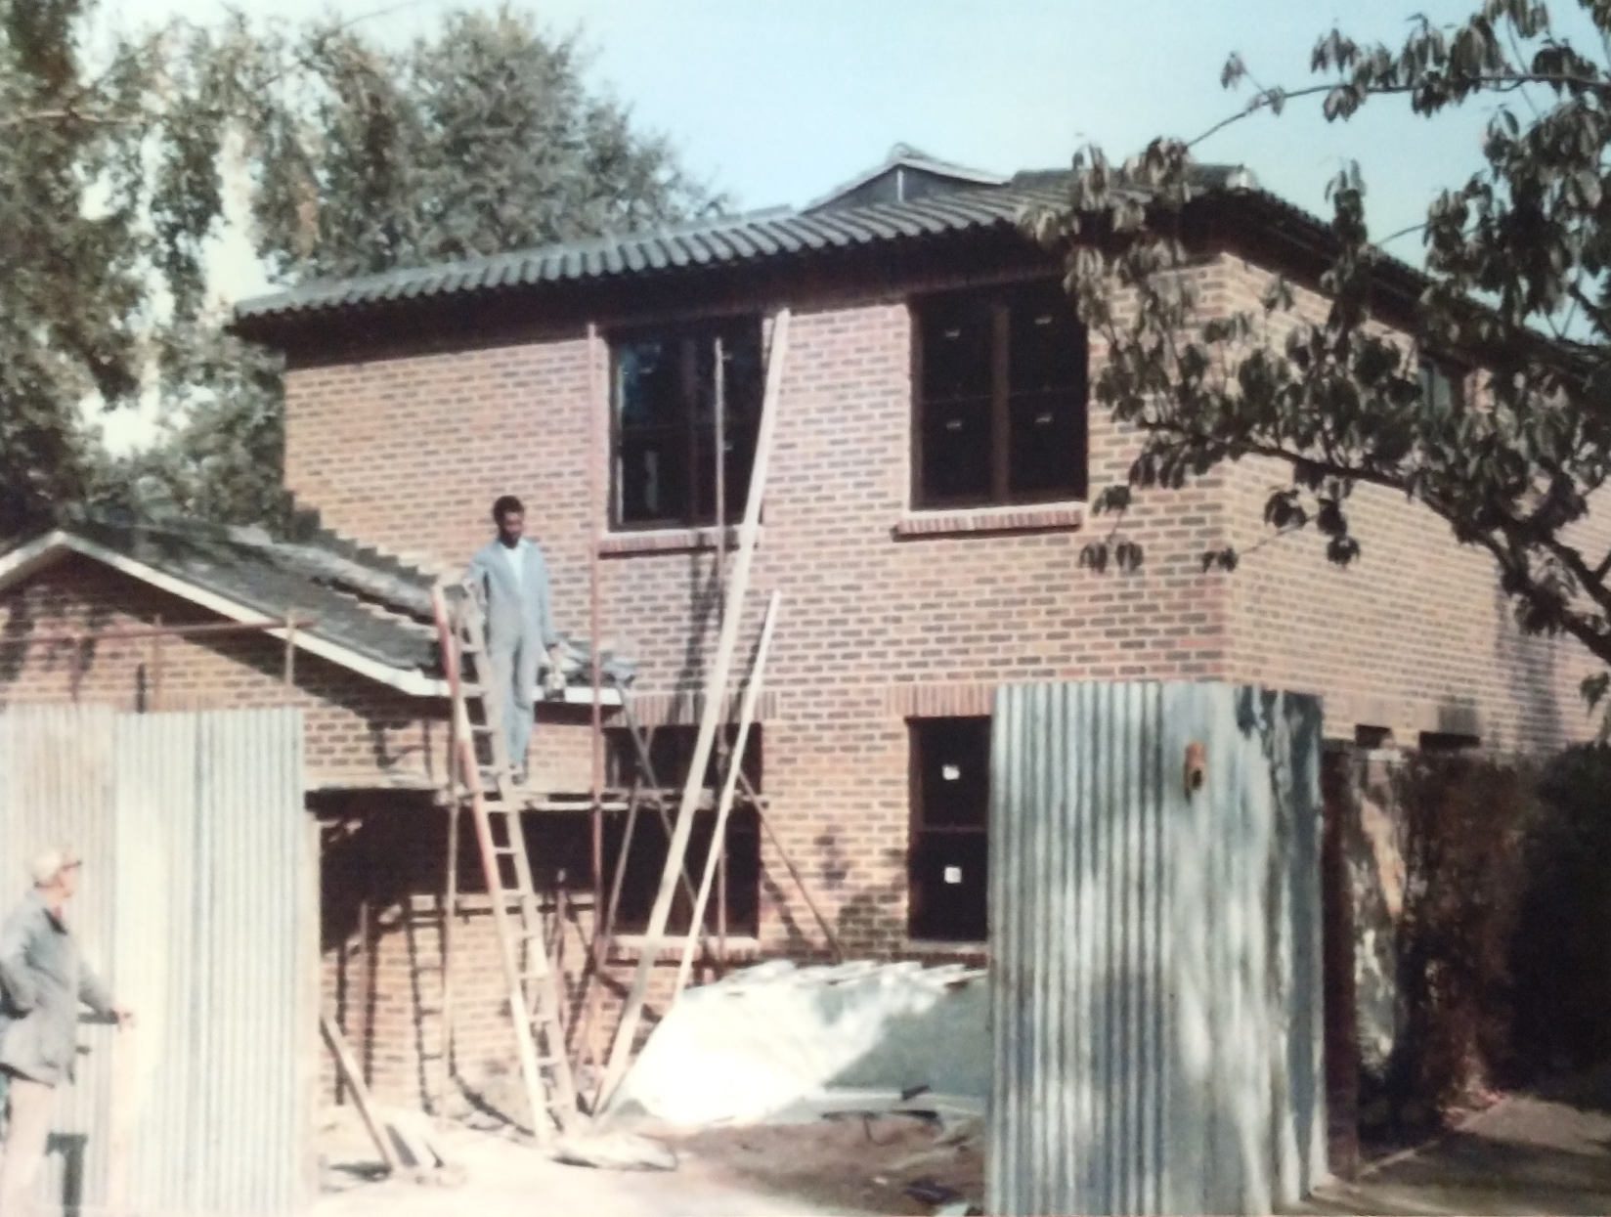
Building work at 2 Burbage Road
1986

Slide 2
Agenda
Welcome, register and apologies
Patient feedback
Services at Elm Lodge Surgery
Services in our neighbourhood
Self-referrals
Any other business

Slide 3
Patient Feedback February 2023

Slide 4
Services at Elm Lodge Surgery (1)
Service | Comments
Face to face GP | 140 per week, 60% booked on same day
Telephone GP | 130 per week, 60% booked on same day Additional triage slots for urgent issues
Practice nurse | Dressings, childhood immunisations, cervical screening, contraception, respiratory reviews, ear syringing, travel vaccines, seasonal vaccines
Health care assistant | Diabetes care processes, NHS health checks, physical health checks, blood tests, B12 injections, ear syringing, seasonal vaccines
Diabetic nurse | Diabetic reviews, prediabetes advice
Elderly care nurse | Holistic assessments and care planning

Slide 5
Services at Elm Lodge Surgery (2)
Service | Comments
Practice based clinical pharmacist | Structured medication reviews, long term conditions, hypertension
Osteopath | Neck and back pain
Dietitian | Advice on maintaining a healthy weight, IBS
Community Dermatology Southwark | Accessed by GP referral
Ambulatory blood pressure clinic | Hypertension diagnosis
Paediatric in-reach clinics | Accessed by GP referral

Slide 6
Services in our neighbourhood
Service | Comments
First contact physiotherapy | Hosted at Chadwick Road, Forest Hill Road and Tessa Jowell
Contraceptive clinic (coils and implants) | Hosted at St Giles
Women’s health clinic | GP led clinic hosted at Tessa Jowell
Social prescribing | Home visits and telephone advice
Health and wellbeing coaching | Home visits and telephone advice
Extended primary care service | Hosted at Tessa Jowell
Cervical screening and childhood immunisations catch-up service | Hosted at Tessa Jowell and Lister Health Centre
LGBT+ health primary care service | Charity funded service for those who feel excluded from traditional primary care

Slide 7
Any Other Business

